Slide 1
Penetration Testing
Finding Vulnerabilities
Dr. Tran The Son
Vietnam – Korea University

Slide 2
Content
Vulnerability vs Exposure
Automated scanning
  Nessus
Targeted analysis
  The Nmap Scripting Engine
  Metasploit Scanner Modules
Manual research

Slide 3
Computer Vulnerability vs Exposure
Vulnerabilities are flaws in computer software, firmware, hardware, and service components that can be exploited by a threat actor to gain unauthorized access and carry out a cyber-attack.
Exposures are errors not inherent to the software, firmware, hardware, or service component that put it at risk of being exploited, such as misconfigurations, open ports, and weak credentials.
CVE, short for common vulnerability and exposure, is a database of publicly disclosed IT security vulnerabilities and exposures.
  assigned a unique CVE identifier (CVE ID) and added to the database (CVE List)

Slide 4
CVE ID
The CVE ID is a vulnerability’s unique identifier.
The standard format of a CVE ID is "CVE-YYYY-NNNN",
  CVE is a fixed prefix,
  YYYY is the year in which the CVE ID was assigned (not necessary the same as when the CVE Record was published),
  NNNN is a random number with at least four digits.
E.g.
  e.g., CVE-2021-12345, CVE-2008-4250 (MS-08-067)
Register a new CVE
https://www.cve.org/

Slide 5
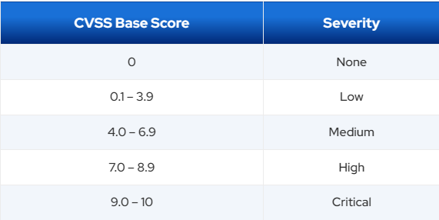
Common Vulnerability Scoring System
The severity of a vulnerability is measured using the Common Vulnerability Scoring System (CVSS). The current version of CVSS is v3.1.
  CVSS consists of three metric groups: Base, Temporal, and Environmental.
  The CVSS Base Score ranges from 0 to 10, with 10 the most severe and 0 posing no risk.
Factor to generate a CVSS score:
Attack vector
Attack complexity
Required privileges
User interaction
Scope
Confidentiality
Integrity
Availability

Slide 6
Exercise
Examine the CVSS v2 Equation
  Check link: https://nvd.nist.gov/vuln-metrics/cvss
Examine Base, Overall scores
  Different Access Vectors
  Different C-I-A
Examine Temporal, Overall scores
  Different Exploitability, Remediation Levels
Examine Environmental, Overall scores
  Collateral Damage Potential
  Target distribution
https://nvd.nist.gov/vuln-metrics/cvss

Slide 7
Exploit Prediction Scoring System (EPSS)
The CVSS is the most frequently cited rating system to assess the severity of security vulnerabilities. It has been criticized, however, as not being appropriate to assess and prioritize risk from those vulnerabilities.
  For this reason, some have called for using the EPSS

Slide 8
Zero-day vulnerabilities
A zero-day (also known as a 0-day) is a vulnerability in a computer system that was previously unknown to its developers or anyone capable of mitigating it.
A zero-day vulnerability is a vulnerability in a system or device that has been disclosed but is not yet patched. An exploit that attacks a zero-day vulnerability is called a zero-day exploit

Slide 9
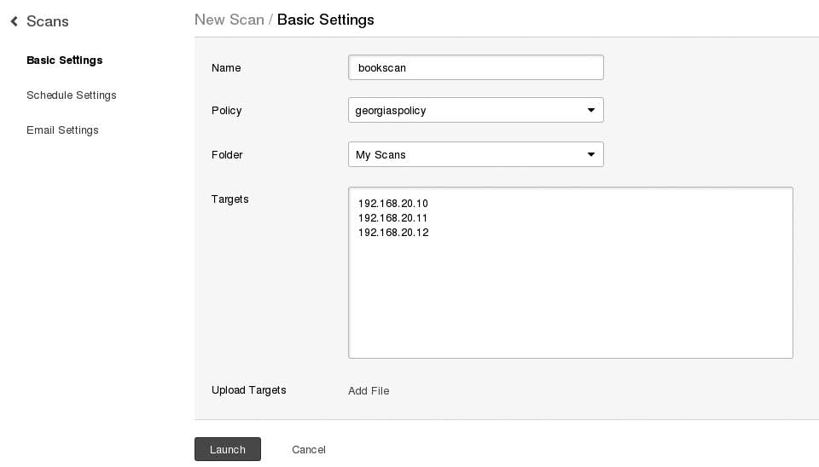
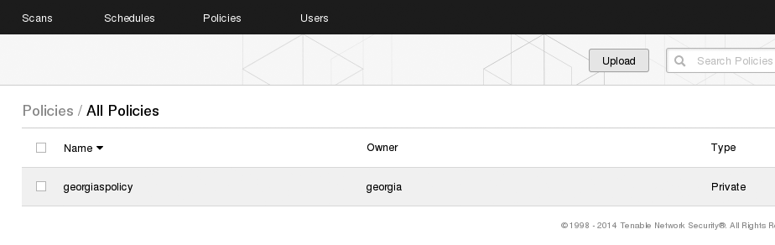
Nessus
Nessus Policies: configuration files that tell Nessus which vulnerability checks, port scanners, and so on to run in the vulnerability scan.
  New Policy → Basic Network Scan
Scanning with Nessus
  Click Scans → New Scan

Slide 10
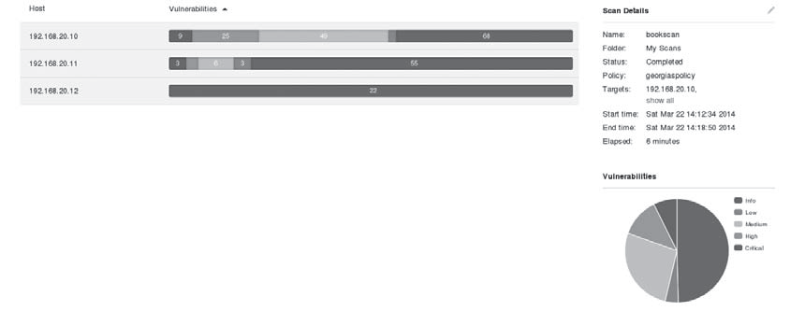
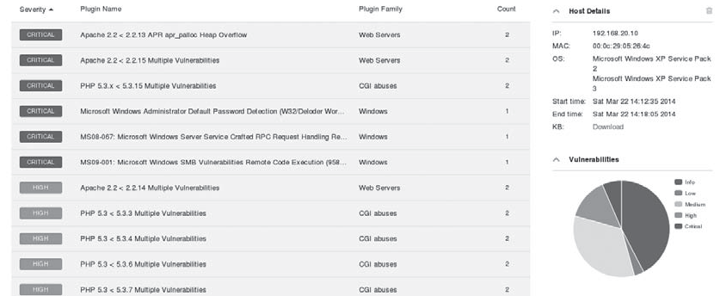
Nessus
Scanning Result
Researching Vulnerabilities
https://www.cve.org/

Slide 11
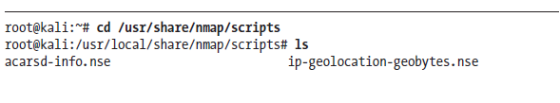

The Nmap Scripting Engine
Nmap has similarly evolved its original goal of port scanning. The Nmap Scripting Engine (NSE) lets you run publicly available scripts and write your own.
in Kali: /usr/share/nmap/scripts.

Slide 12
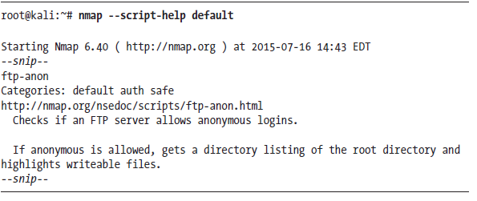
The Nmap Scripting Engine
nmap --script-help default
Some NSE scripts may crash services or harm the target system, and an entire category is dedicated to denial of service. For example, the script smb-check-vulns will check for the MS08-067 vulnerability and other SMB vulnerabilities. Its help information notes that this script is likely dangerous and shouldn’t be run on production systems unless you are prepared for the server to go down.

Slide 13
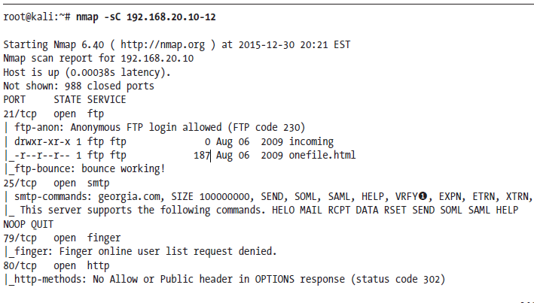
The Nmap Scripting Engine
To tell Nmap to run a script scan in addition to port scanning
    use the -sC flag

Slide 14
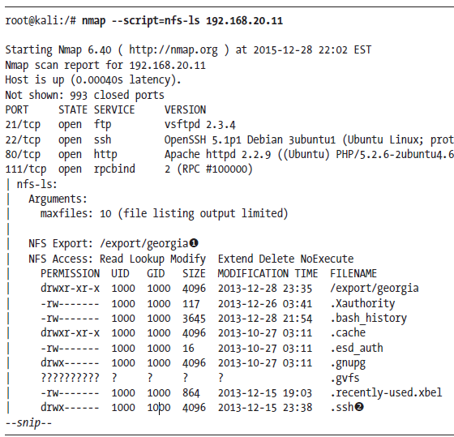
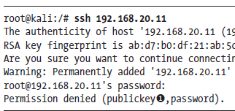
The Nmap Scripting Engine
Running a Single NSE Script

Slide 15
Exercise
Access to Win XP machine
  Get file via FTP port
  Send mail via SMPT port

Slide 16
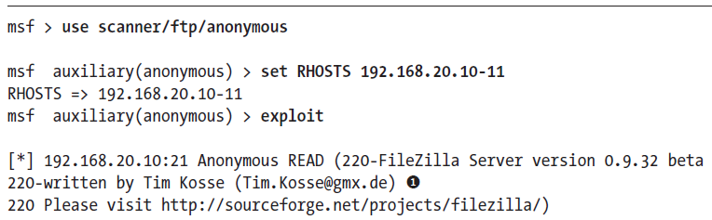
Metasploit Scanner Modules
these modules will not give us control of the target machine, but they will help us identify vulnerabilities for later exploitation.
To choose a particular module, we use the module, then we define our targets with set, and then scan with the exploit command,

Slide 17
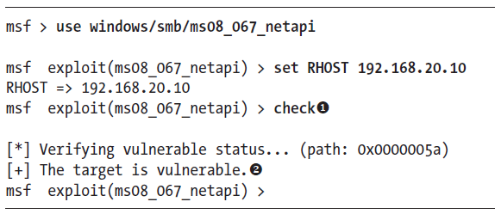
Metasploit Exploit Check Functions
Some Metasploit exploits include a check function that connects to a target to see if it is vulnerable, rather than attempting to exploit a vulnerability.

Slide 18
Web Application Scanning
Web application issues are particularly interesting on many external penetration tests where your attack surface may be limited to little more than web servers
  Nikto
  Attacking XAMPP
  Default Credentials

Slide 19
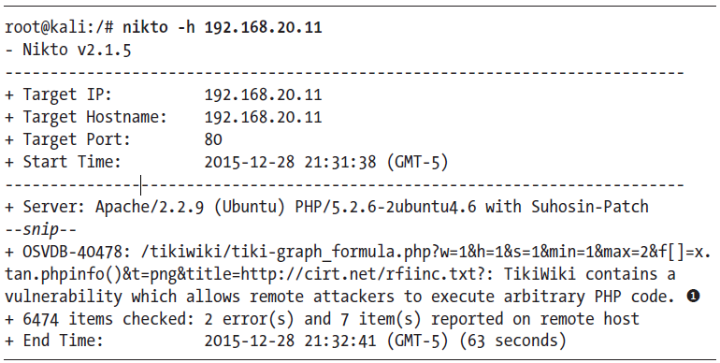
Nikto
Nikto is a web application vulnerability scanner built into Kali that’s like Nessus for web apps.
To run Nikto against our Linux target, we tell it which host to scan with the -h flag

Slide 20
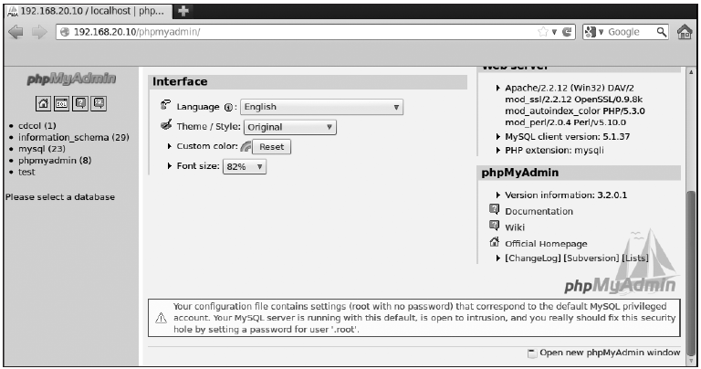
Attacking XAMPP
XAMPP 1.7.2
    the phpMyAdmin install at http://192.168.20.10/phpmyadmin/ is available and open

Slide 21
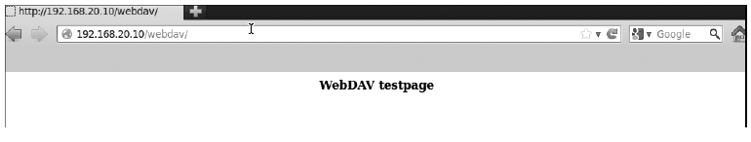
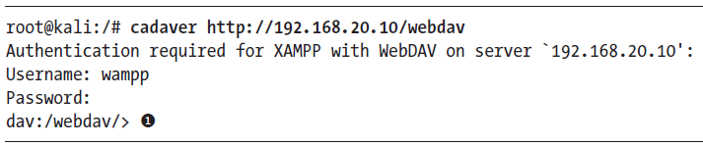
Default Credentials
XAMPP 1.7.3 and earlier come with Web Distributed Authoring and Versioning (WebDAV) software, which is used to manage files on a web server over HTTP. XAMPP’s WebDAV installation comes with the default username and password wampp:xampp
We can use Cadaver to interact with WebDAV servers

Slide 22
Manual Analysis
Exploring a Strange Port
Finding Valid Usernames

Slide 23
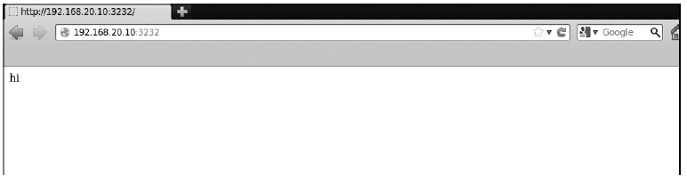
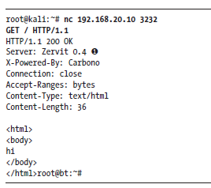
Exploring a Strange Port
One port that has failed to come up in our automated scans is 3232 (or any) on our Windows target
we can enter GET / HTTP/1.1 to ask the web server for the default page
Index.html

Slide 24
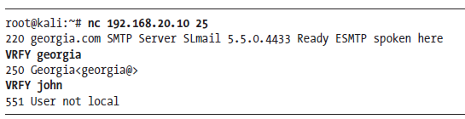
Finding Valid Usernames
We can drastically increase our chances of a successful password attack if we know valid usernames for services.
To find valid usernames for mail servers is to use the VRFY SMTP command

